Slide 1
User interface design

Slide 2
Topics covered
Design issues
The user interface design process
User analysis
User interface prototyping
Interface evaluation

Slide 3
The user interface
User interfaces should be designed to match the skills, experience and expectations of its anticipated users.
System users often judge a system by its
interface rather than its functionality.
A poorly designed interface can cause a user to make catastrophic errors.
Many so-called “user errors” are caused by the fact that user interfaces do not consider the capabilities of real users and their working environment.
Poor user interface design is the reason why so many software systems are never used.

Slide 4
Human factors in interface design
Limited short-term memory
  People can instantaneously remember about 7 items of information. If you present more than this, they are more liable to make mistakes.
People make mistakes
  When people make mistakes and systems go wrong, inappropriate alarms and messages can increase stress and hence the likelihood of more mistakes.
People are different
  People have a wide range of physical capabilities. Designers should not just design for their own capabilities.

Slide 5
UI design principles
UI design must take account of the needs, experience and capabilities of the system users.
Designers should be aware of people’s physical and mental limitations (e.g. limited short-term memory) and should recognise that people make mistakes.

Slide 6
Design principles -1
User familiarity
  The interface should be based on user-oriented
  terms and concepts rather than computer concepts. For example, an office system should use concepts such as letters, documents, folders etc. rather than directories, file identifiers, etc. The underlying implementation of the interface in terms of files and data structures should be hidden from the end-user.
Consistency
  The system should display an appropriate level
  of consistency. Commands and menus should have the same format, command punctuation should be similar, etc. Consistent interfaces reduce user learning time. But complete consistency is neither possible nor desirable.

Slide 7
Design principles -2
Minimal surprise
  If a command operates in a known way, the user should be
  able to predict the operation of similar commands.
Recoverability
  The system should provide some resilience to
  user errors and allow the user to recover from errors. This might include an undo facility, confirmation of destructive actions etc.
User guidance
  Some user guidance such as help systems, on-line manuals, etc. should be supplied.These should provide different levels of help.
User diversity
  Interaction facilities for different types of user should be supported. For example, some users have seeing difficulties and so larger text should be available or experienced users and inexperienced users etc.

Slide 8
Design issues in UIs
Two problems must be addressed in interactive systems design
  How should information from the user be provided to the computer system?
  How should information from the computer system be presented to the user?
User interaction and information presentation may be integrated through a coherent framework such as a user interface metaphor.

Slide 9
Interaction styles
Direct manipulation: The user interacts directly with objects on the screen. For ex; to delete a file, you may click on an icon representing that file and drag it to a trash can icon.
Menu selection: The user selects a command from a list of possibilities.
Form fill-in: The user fills in the fields of a form
Command language: The user issues a special command and associated parameters to instruct the system what to do.
Natural language: The user issues a command in natural language. The natural language is parsed and translated to system commands.

Slide 10
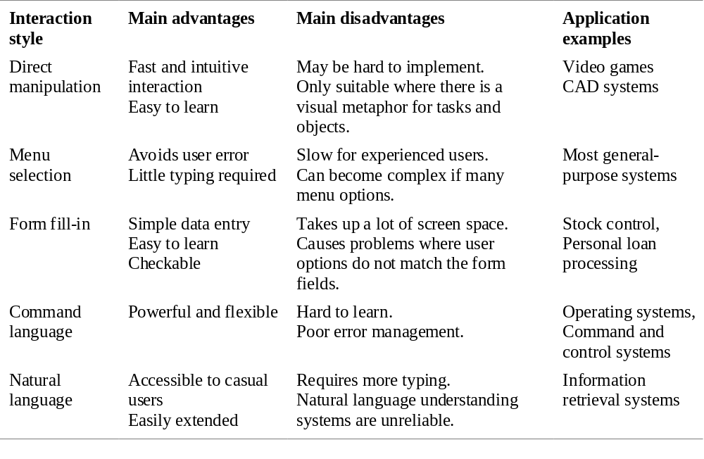
Interaction styles

Slide 11
Web-based interfaces
Since web-based systems are usually designed for casual users, most of them use form-base interfaces.
Form field can be menus, free text input, radio buttons, etc.
In the LIBSYS example, users make a choice of where to search from a menu and type the search phrase into a free text field.(document search and document request)

Slide 12
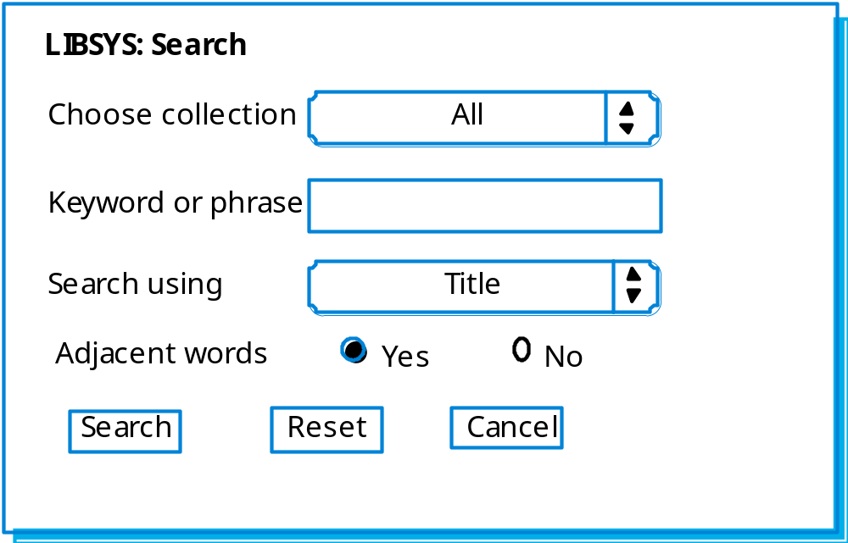
LIBSYS search form

Slide 13
Information presentation
Information presentation is concerned with presenting system information to system users.
The information may be presented directly (e.g. text in a word processor) or may be transformed in some way for presentation (e.g. in some graphical form).
The Model-View-Controller approach is a way of supporting multiple presentations of data.

Slide 14
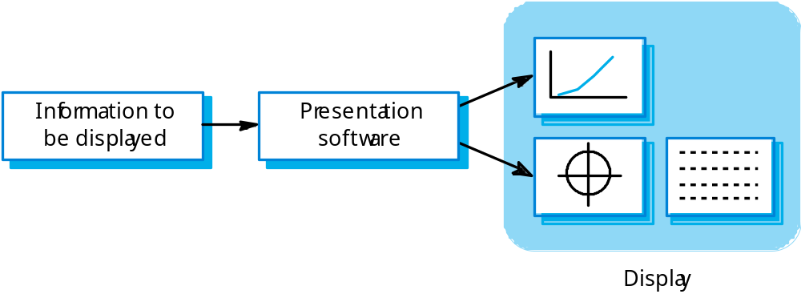
Information presentation

Slide 15
Information presentation
Static information
  Initialised at the beginning of a session. It does not change during the session.
  May be either numeric or textual.
Dynamic information
  Changes during a session and the changes must be communicated to the system user.
  May be either numeric or textual.

Slide 16
Information display factors
Is the user interested in precise information or
data relationships?
How quickly do information values change?
Must the change be indicated immediately?
Must the user take some action in response to
a change?
Is there a direct manipulation interface?
Is the information textual or numeric? Are relative values important?

Slide 17
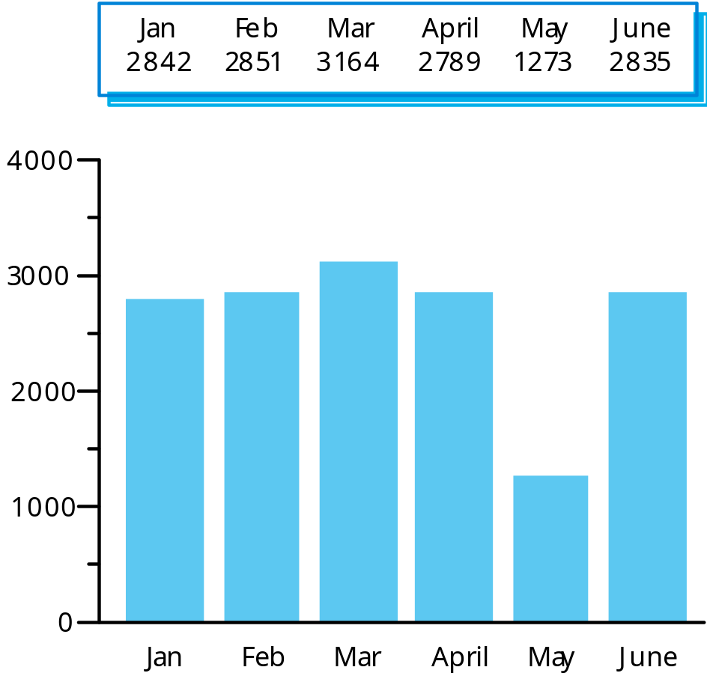
Alternative information presentations

Slide 18
Analogue or digital presentation?
Digital presentation
  Compact - takes up little screen space;
  Precise values can be communicated.
Analogue presentation
  Easier to get an 'at a glance' impression of a value;
  Possible to show relative values;
  Easier to see exceptional data values.

Slide 19
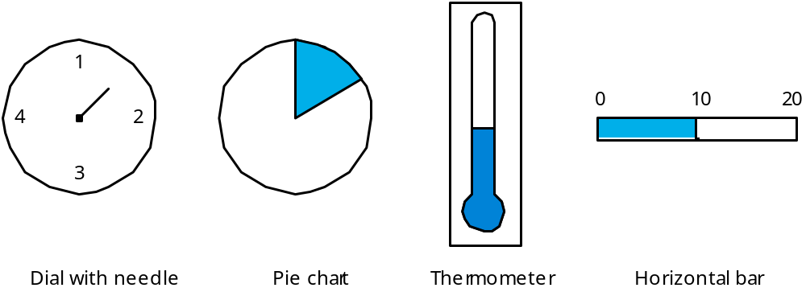
Presentation methods

Slide 20
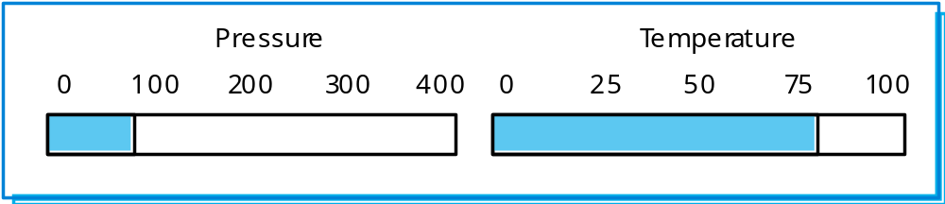
Displaying relative values

Slide 21
Data visualisation
Concerned with techniques for displaying large amounts of information.
Visualisation can reveal relationships between entities and trends in the data.
Possible data visualisations are:
  Weather information collected from a number of sources;
  The state of a telephone network as a linked set of nodes;
  Chemical plant visualised by showing pressures and temperatures in a linked set of tanks and pipes;
  A model of a molecule displayed in 3 dimensions;

Slide 22
Colour displays
Colour adds an extra dimension to an interface and can help the user understand complex information structures.
Colour can be used to highlight exceptional events.
An example for a common mistake in the use of colour in interface design include the over-use of colour in the display.

Slide 23
Colour use guidelines
Limit the number of colours used and be conservative in their use.
Use colour change to show a change in system status.
Use colour coding in a thoughtful and consistent way.
Be careful about colour pairings.

Slide 24
Error messages
Error message design is critically important.
Poor error messages can mean that a user
rejects rather than accepts a system.
Messages should be polite, concise, consistent and constructive.
The background and experience of users
should be the determining factor in message
design.

Slide 25
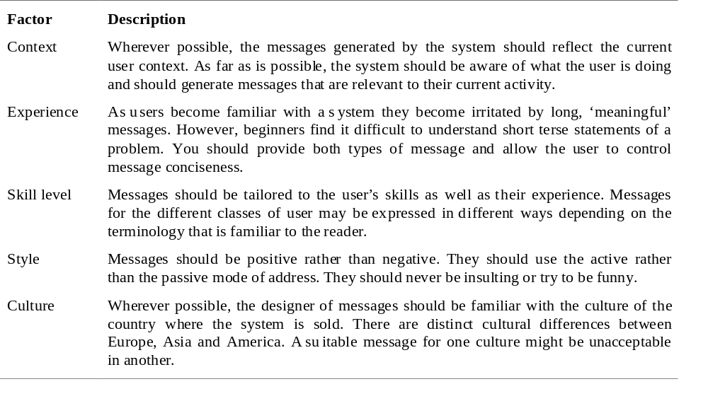
Design factors in message wording

Slide 26
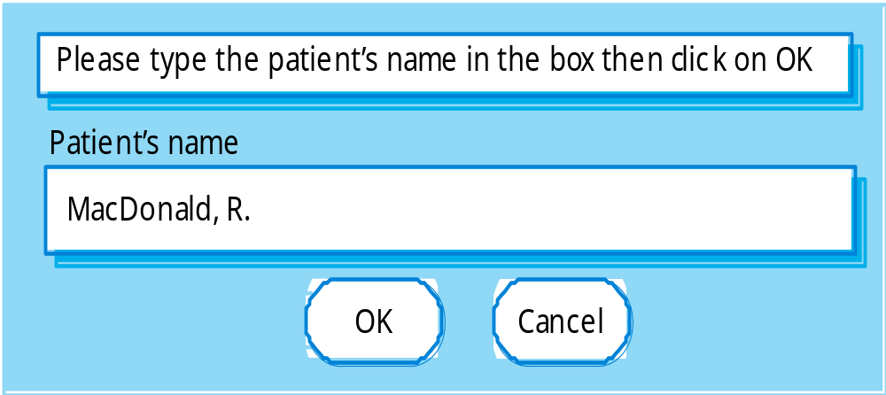
User error
Assume that a nurse misspells the name of a patient whose records he is trying to retrieve.

Slide 27

Good and bad message design
User-orient
ed error message
Syst
em-orient
ed error message
Err
or #2
7
R. MacDonald is not a reg
ist
ered patient
In
v
Clic
k on P
atients f
or a list of patients
alid patient id
Clic
k on Retr
y to re-input the patient’s name
Clic
k on Help f
or more inf
or
mation
OK
Cancel
P
atients
Help
Retr
y
Cancel

Slide 28
User documentation
As well as on-line information, paper documentation should be supplied with a system
Documentation should be designed for a range of users from inexperienced to experienced
As well as manuals, other easy-to-use documentation such as a quick reference card may be provided

Slide 29
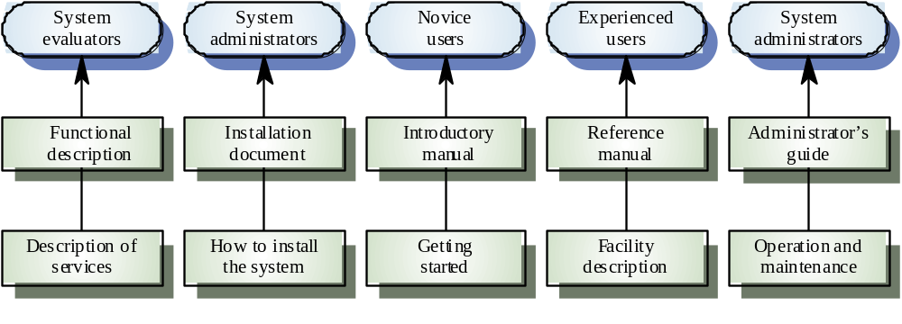
User document types

Slide 30
Document types
Functional description: Brief description of what the system can do
Introductory manual: Presents an informal introduction to the system
System reference manual: Describes all system facilities in detail
System installation manual: Describes how to install the system
System administrator’s manual: Describes how to manage the system when it is in use

Slide 31
The UI design process
UI design is an iterative process between users and designers.
The 3 core activities in this process are:
  User analysis. Understand what the users will do with the system;
  System prototyping. Develop a series of prototypes for experiment;
  Interface evaluation. Experiment with these prototypes with users.

Slide 32
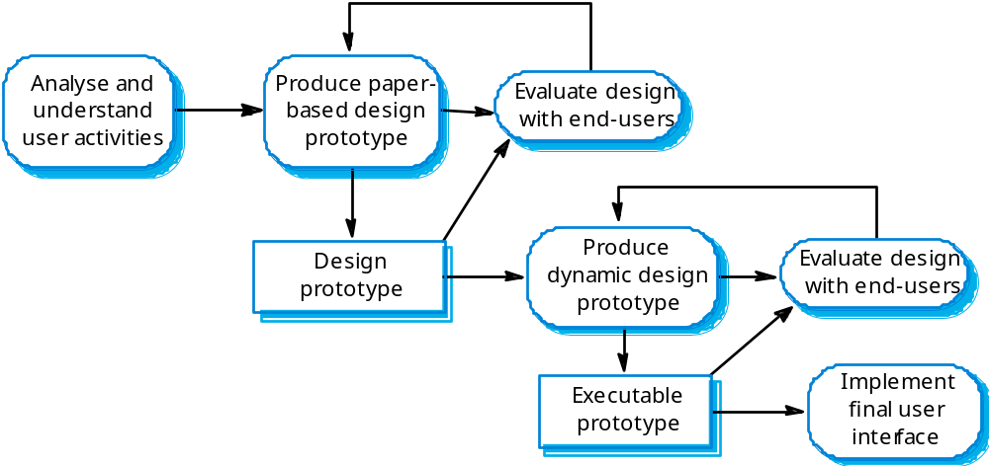
The design process

Slide 33
User analysis
If you don’t understand what the users want to do with a system, you have no realistic prospect of designing an effective interface.
User analyses have to be described in terms that users and other designers can understand.
Scenarios where you describe typical episodes of use, are one way of describing these analyses.

Slide 34
Analysis techniques
Task analysis
  Models the steps involved in completing a task.
Interviewing and questionnaires
  Asks the users about the work they do.
Ethnography
  Observes the user at work.

Slide 35
Interviewing
Design semi-structured interviews based on open-ended questions.
Users can then provide information that they think is essential; not just information that you have thought of collecting.
Group interviews and allow users to discuss with each other what they do.

Slide 36
Ethnography
Involves an external observer watching users at work and questioning them in an unscripted way about their work.
Valuable because many user tasks are intuitive and they find these very difficult to describe and explain.
Also helps understand the role of social and organisational influences on work.

Slide 37
User interface prototyping
The aim of prototyping is to allow users to gain direct experience with the interface.
Without such direct experience, it is impossible to judge the usability of an interface.
Prototyping may be a two-stage process:
  Early in the process, paper prototypes may be used;
  The design is then refined and increasingly sophisticated automated prototypes are then developed.

Slide 38
Paper prototyping
Work through scenarios using sketches of the interface.
Use a storyboard to present a series of interactions with the system.
Paper prototyping is an effective way of getting user reactions to a design proposal.

Slide 39
User interface evaluation
Some evaluation of a user interface design
should be carried out to assess its suitability.
Full scale evaluation is very expensive and
impractical for most systems.
Ideally, an interface should be evaluated against a usability specification. However, it is rare for such specifications to be produced.

Slide 40
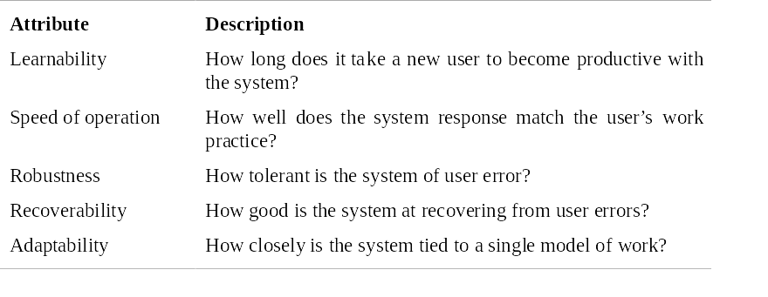
Usability attributes

Slide 41
Simple evaluation techniques
Questionnaires for user feedback.
Video recording of system use and subsequent tape evaluation.
Instrumentation of code to collect information about facility use and user errors.
The provision of code in the software to collect on-line user feedback.

